Slide 1

Practical Guide to State-Of-the-Art Large Language Models
OpSTech Machine Learning Subguid

Slide 2
Agenda
What is Transformer?
OpenAI API demo (completion, chat and fine-tuning)
LLAMA2 : Running LLM on local machine

Slide 3
Transformer

Slide 4
Popular Large Language Models
Open AI GPT
Generative Pre-Trained Transformer
Google BERT
Bidirectional Encoder Representations from Transformers
Facebook Llama
Based on the Transformer architecture with various improvements

Slide 5
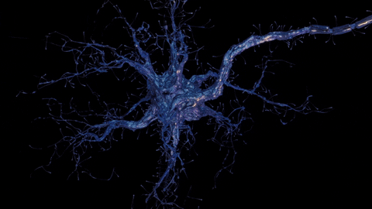
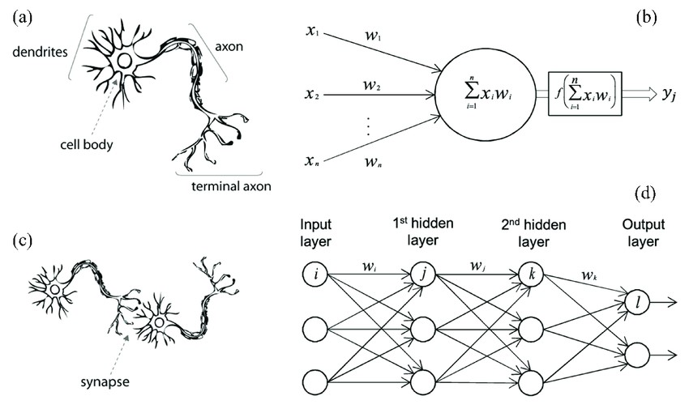
What is a neural network?
A biological neuron in comparison to an artificial neural network: (a) human neuron; (b) artificial neuron; (c) biological synapse; and (d) ANN synapses [39].

Slide 6
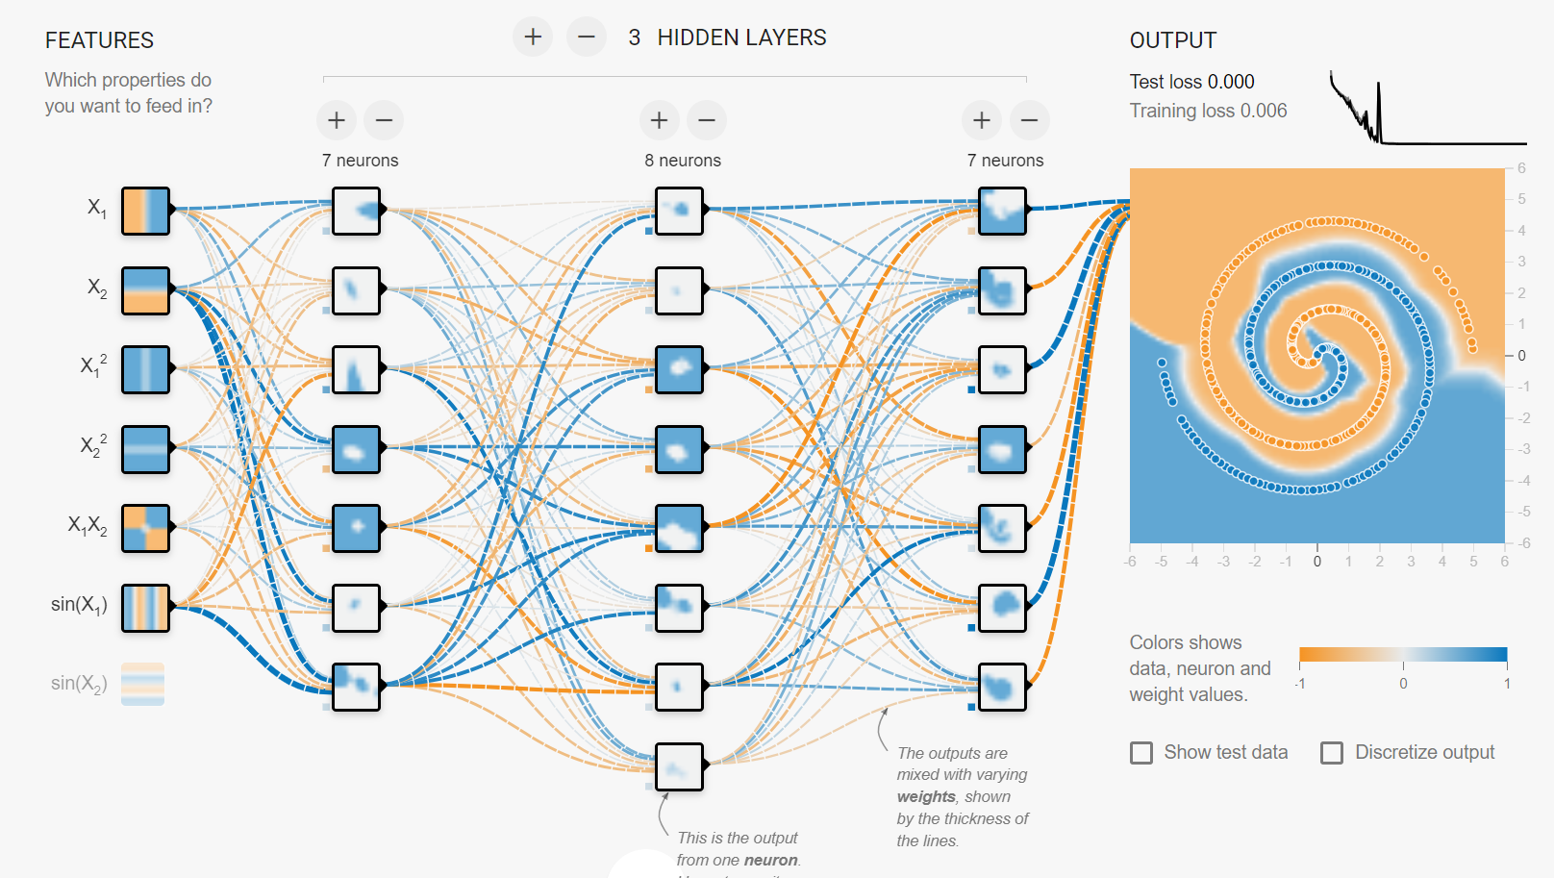
Example (Click here - playground)

Slide 7
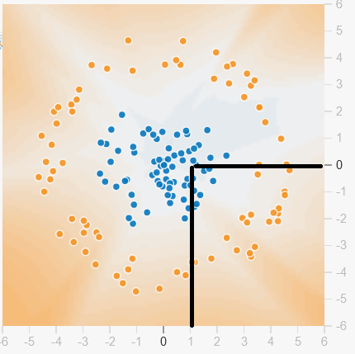
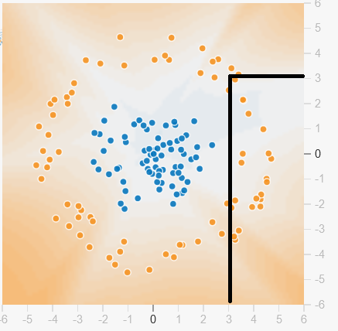
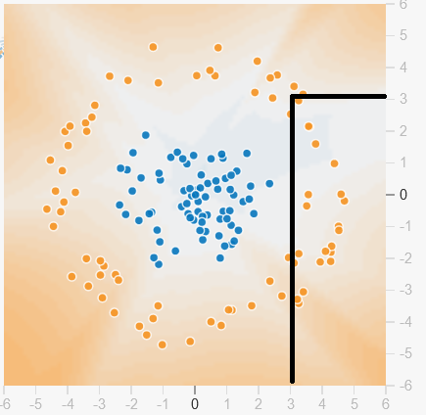
Neural Network = Function Approximator
f (1,0) = Blue
f (3,3) = Orange

Slide 8
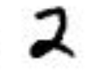
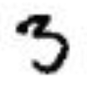


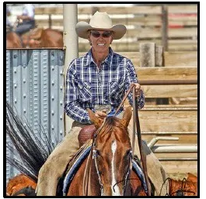
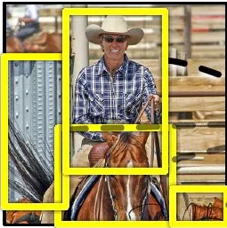
f ( ) = 3
f ( ) = 2
f ( ) = dog
f ( ) = cat
f ( ) = Person

Slide 9
Language Example
f (“I have a dog and a c____” ) = cat
f (“The CEO of Morgan ____” ) = Stanley
f (“public static void ____” ) = main
f (“How are you?”) = comment ça va? (French)

Slide 10
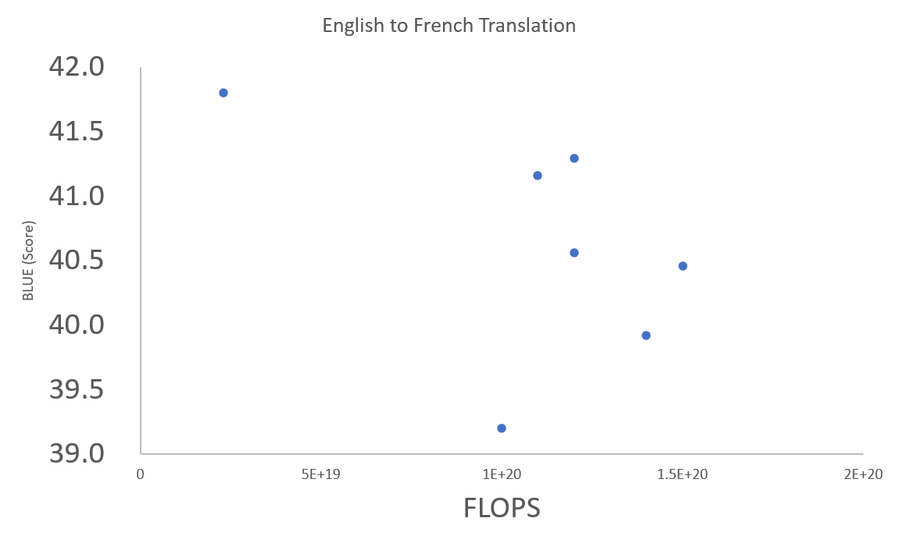
Performance and Cost of training Models
ConvS2S Ensemble (2017)
GNMT + RL Ensemble (2016)
MoE (2017)
ConvS2S (2017)
GNMT + RL (2016)
Deep-Att + PosUnk (2016)
BLEU (bilingual evaluation understudy)

Slide 11
TRANSFORMER IS HERE! (Best performance with 10x Smaller training Cost)
Transformer
ConvS2S Ensemble (2017)
GNMT + RL Ensemble (2016)
MoE (2017)
ConvS2S (2017)
GNMT + RL (2016)
Deep-Att + PosUnk (2016)

Slide 12
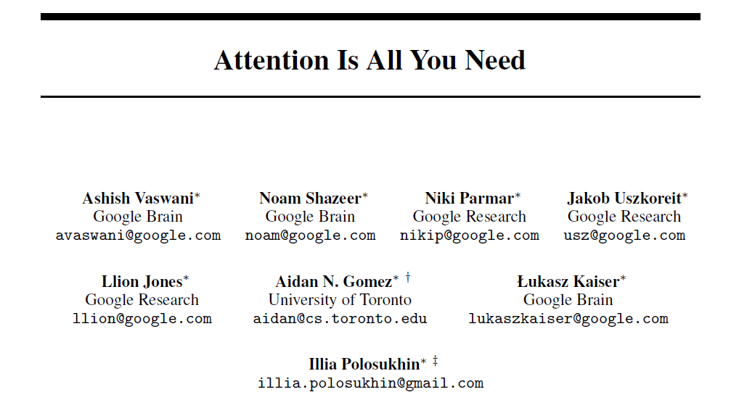
31st Conference on Neural Information Processing Systems (NIPS 2017), Long Beach, CA, USA.

Slide 13
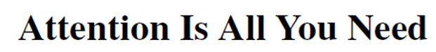
Abstract
The dominant sequence transduction models are based on complex recurrent or convolutional neural networks that include an encoder and a decoder. The best performing models also connect the encoder and decoder through an attention mechanism. We propose a new simple network architecture, the Transformer, based solely on attention mechanisms, dispensing with recurrence and convolutions entirely. Experiments on two machine translation tasks show these models to be superior in quality while being more parallelizable and requiring significantly less time to train. Our model achieves 28.4 BLEU on the WMT 2014 English to German translation task, improving over the existing best results, including ensembles, by over 2 BLEU. On the WMT 2014 English-to-French translation task,
our model establishes a new single-model state-of-the-art BLEU score of 41.8 after training for 3.5 days on eight GPUs, a small fraction of the training costs of the best models from the literature. We show that the Transformer generalizes well to other tasks by applying it successfully to English constituency parsing both with large and limited training data.

Slide 14
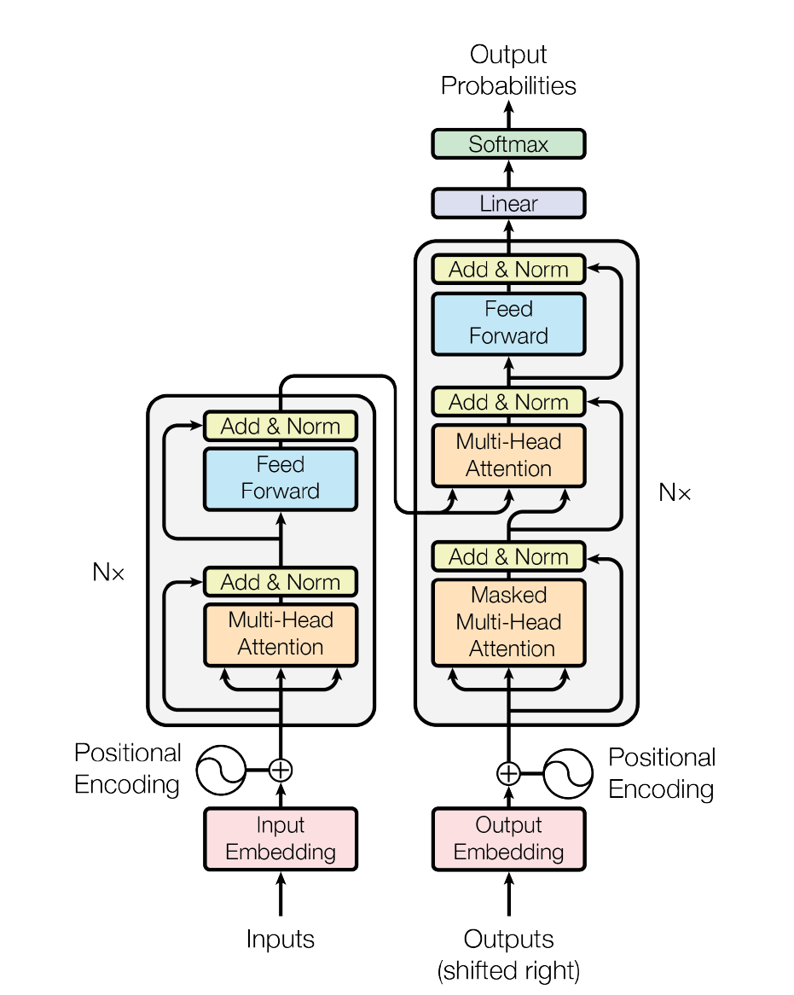
Self attention mechanisms
Parallelizable
Requiring significantly less time to train
Generalizes well to other tasks

Slide 15
transformer internals - self attention? - Encoder & Decoder? - Heads? - Positional encoding? - Dropout? - Masked Attention? - SoftMax - Linear
WIP

Slide 16
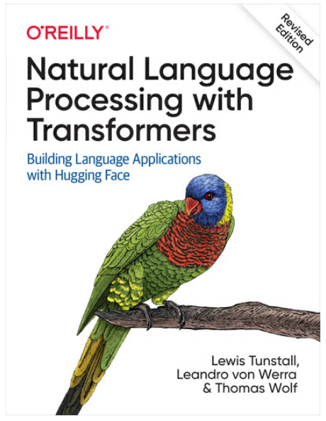
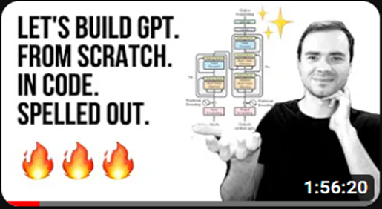

For more about transformer:
https://youtu.be/kCc8FmEb1nY

Slide 17
So…. How much does it cost to create a model like GPT?
$

Slide 18
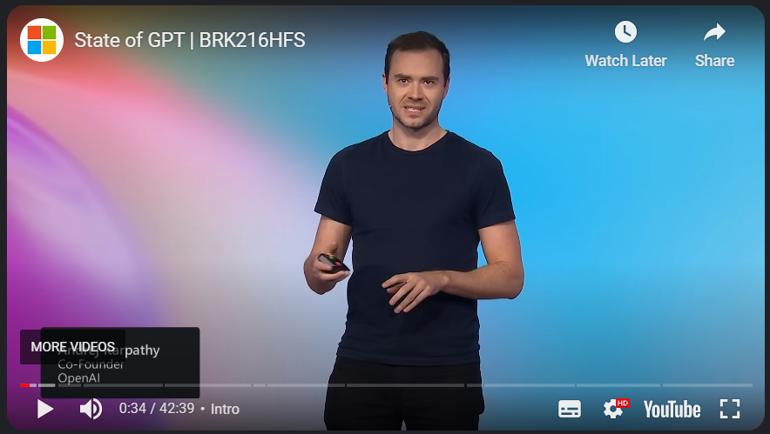
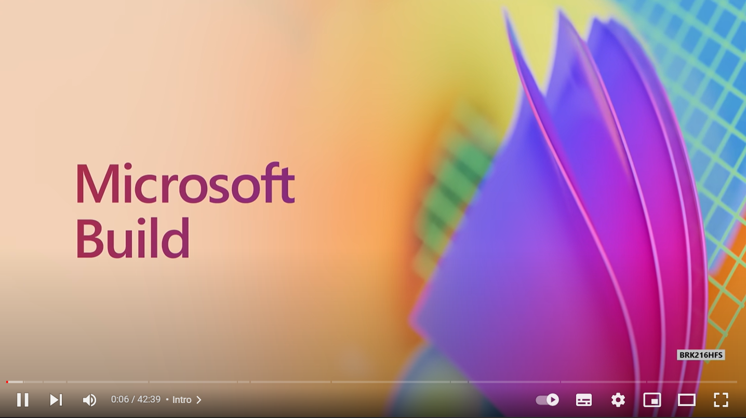
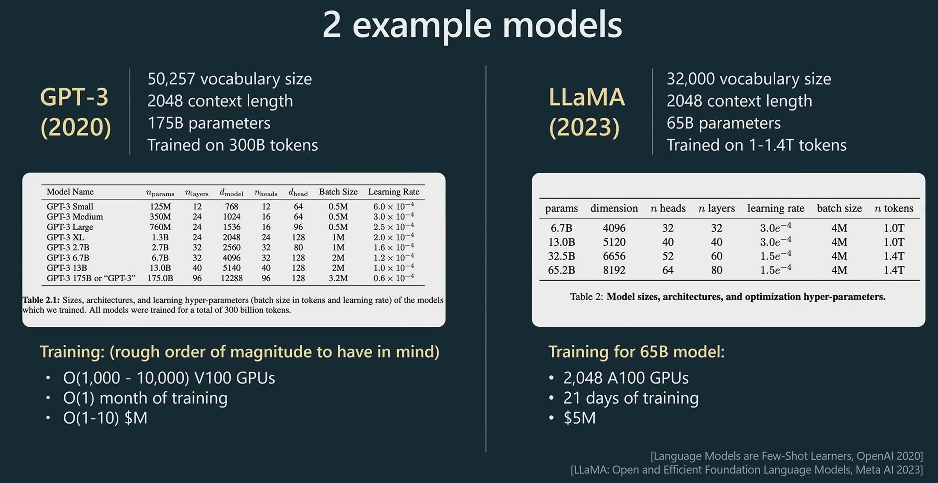
Microsoft Build 2023
State of GPT – Andrej Karpathy
https://youtu.be/bZQun8Y4L2A?t=116

Slide 19
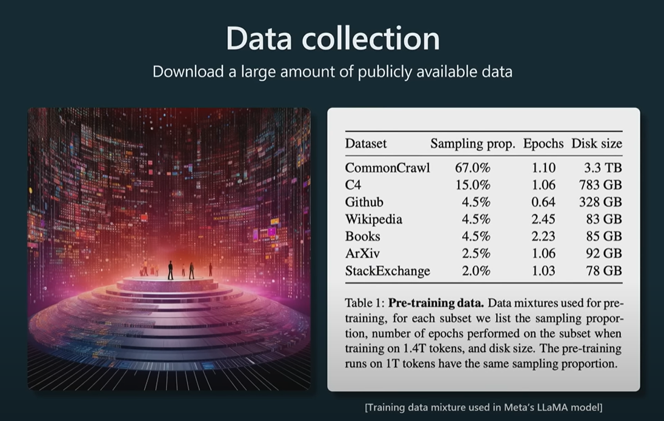
Microsoft Build 2023

Slide 20
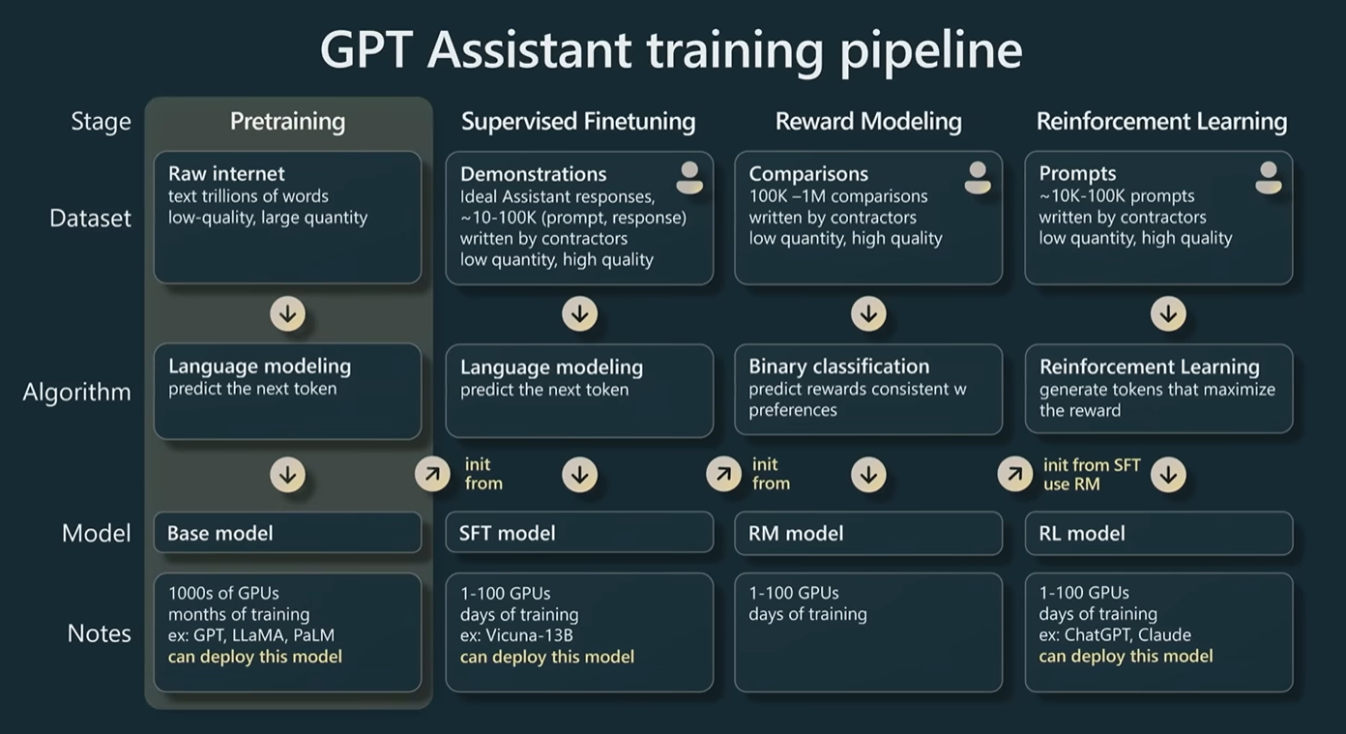
Microsoft Build 2023

Slide 21
Good news is… The good news is that pre-trained models are available We can use them through an API, or we can even install them on your local machine

Slide 22
Popular Large Language Models
Open AI GPT
Generative Pre-Trained Transformer
Facebook Llama
Based on the Transformer architecture with various improvements

Slide 23
OpenAI API Demo

Slide 24
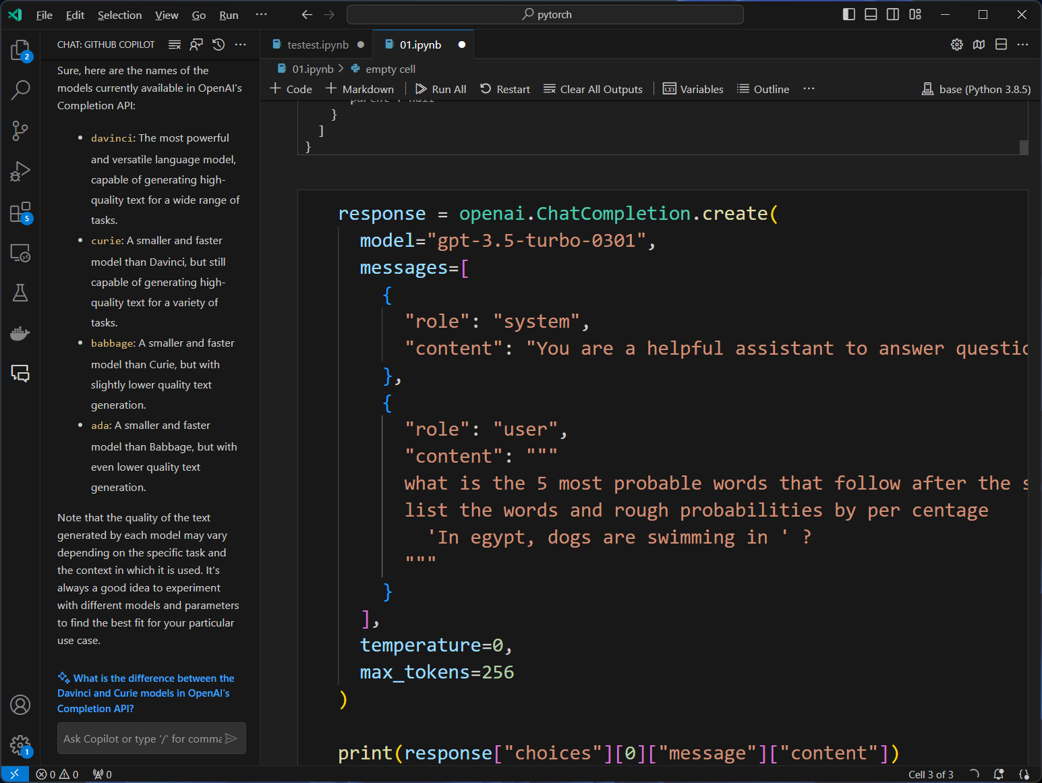
Demo: OpenAI demo
Live demo of using OpenAI API
WIP
Completion
Chat
Fine-tuning

Slide 25
LLAMA2 Demo

Slide 26
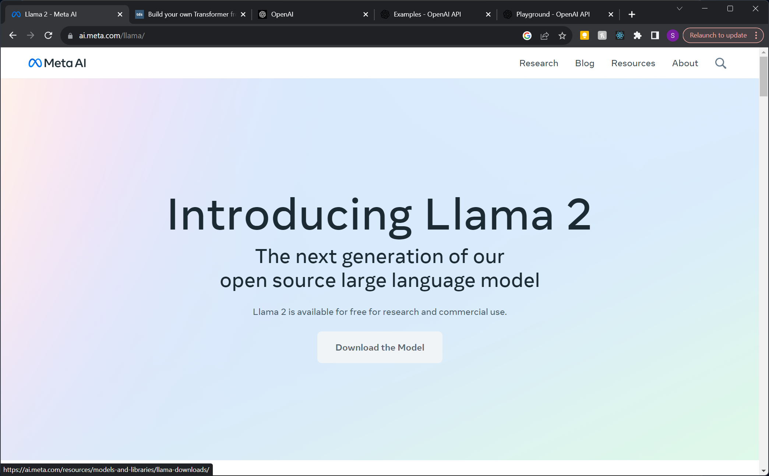
WIP

Slide 27

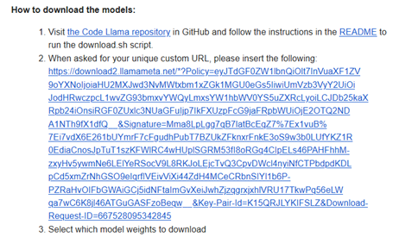
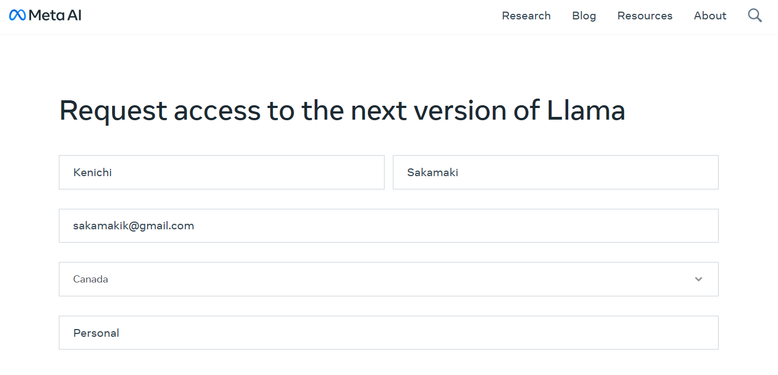
Request Access
https://ai.meta.com/resources/models-and-libraries/llama-downloads/

Slide 28
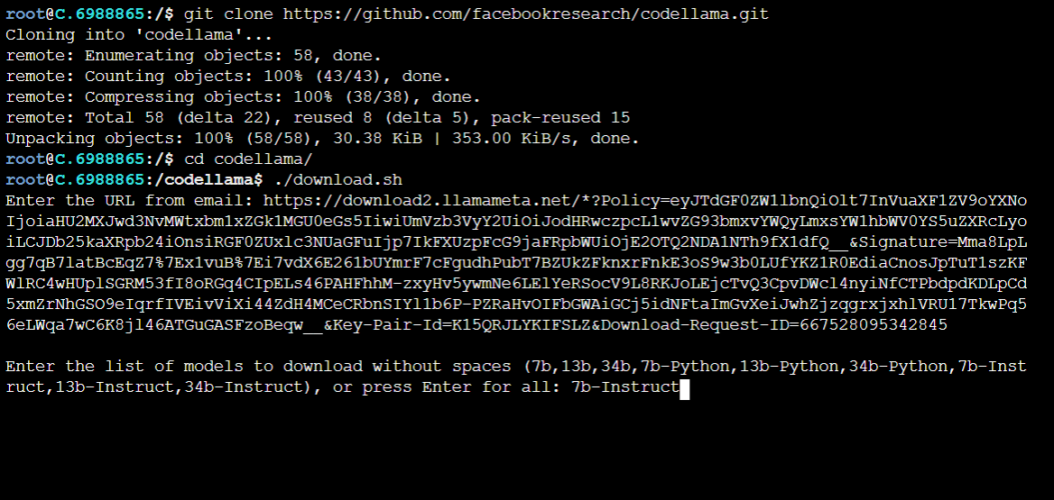
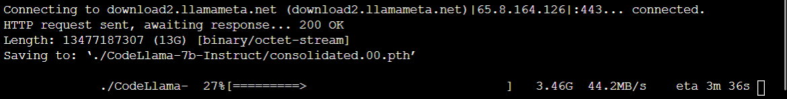
Git clone and download model

Slide 29
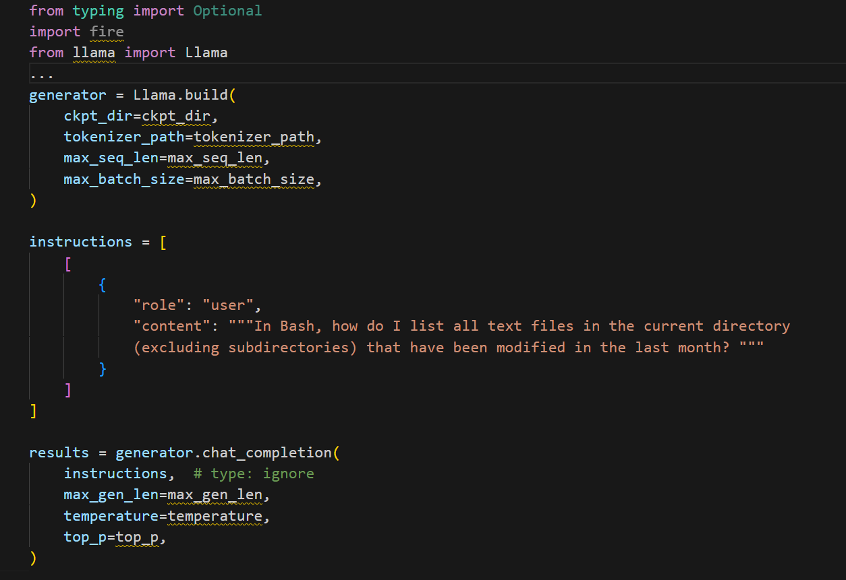

Slide 30
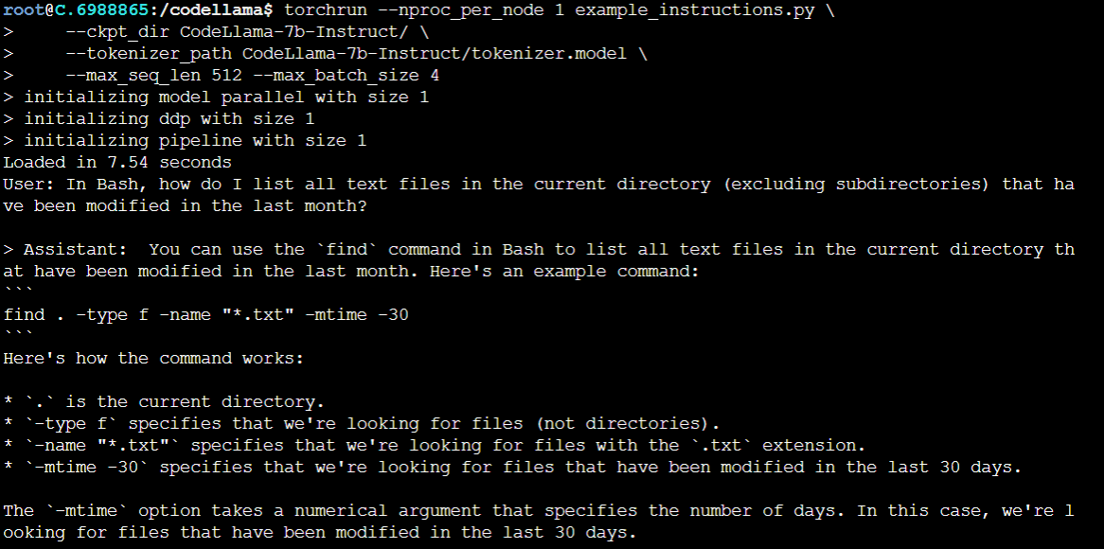

Slide 31



